Slide 1
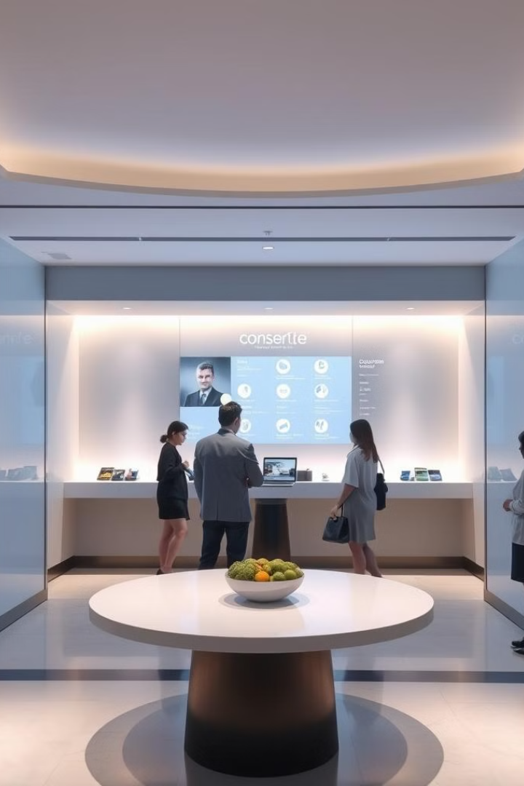
AI-Driven Guest Experience Personalization System for Hospitality
by Durga Sri R

Slide 2
Introduction
This presentation introduces an innovative AI-driven Guest Experience Personalization System designed to enhance the hospitality industry. Our system leverages the power of artificial intelligence to create truly customized and memorable experiences for every guest. We will explore the system's architecture, functionalities, and potential impact on guest satisfaction.

Slide 3
Problem Statement
Current Challenges in Hospitality
The hospitality industry faces challenges in delivering consistently personalized guest experiences. Traditional methods struggle to scale personalization effectively, leading to inconsistent service and missed opportunities to anticipate guest needs. Proactive issue resolution is often reactive, and gathering and analyzing guest feedback for continuous improvement is time-consuming and inefficient. Furthermore, maintaining data privacy while leveraging guest data for personalization presents significant security and ethical concerns. Finally, integrating various systems and data sources to create a unified view of the guest can be complex and expensive.

Slide 4
Objectives
—
—
Enhance Guest Experience
Improve Operational Efficiency
Develop a system that provides highly personalized and memorable guest experiences.
Streamline processes, reduce manual tasks, and improve response times to guest requests.
—
—
Increase Guest Satisfaction
Optimize Resource Allocation
Elevate guest satisfaction scores through proactive service and personalized attention.
Improve resource management by predicting guest needs and allocating resources effectively.

Slide 5
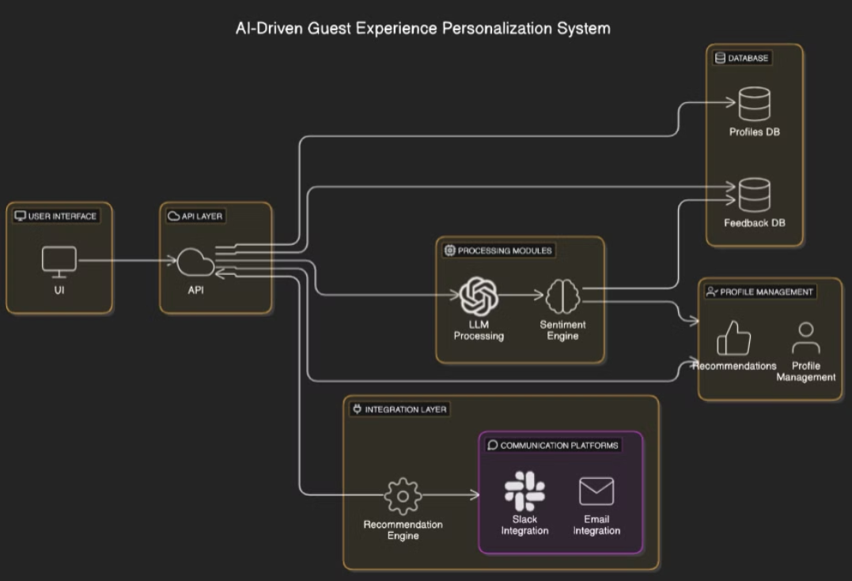
Architecture Diagram

Slide 6
Future Improvements
First, we will improve AI accuracy by implementing advanced machine learning algorithms. This will enable more precise predictions of guest needs and preferences, resulting in even more personalized experiences.
Second, we will prioritize seamless integration with existing hotel management systems and other relevant platforms. This will optimize data flow and enhance overall operational efficiency.
Finally, we aim to expand personalization to encompass a wider range of guest interactions and preferences, such as dietary restrictions, accessibility needs, and communication channels. This will ensure the system adapts to evolving hospitality industry demands.

Slide 7
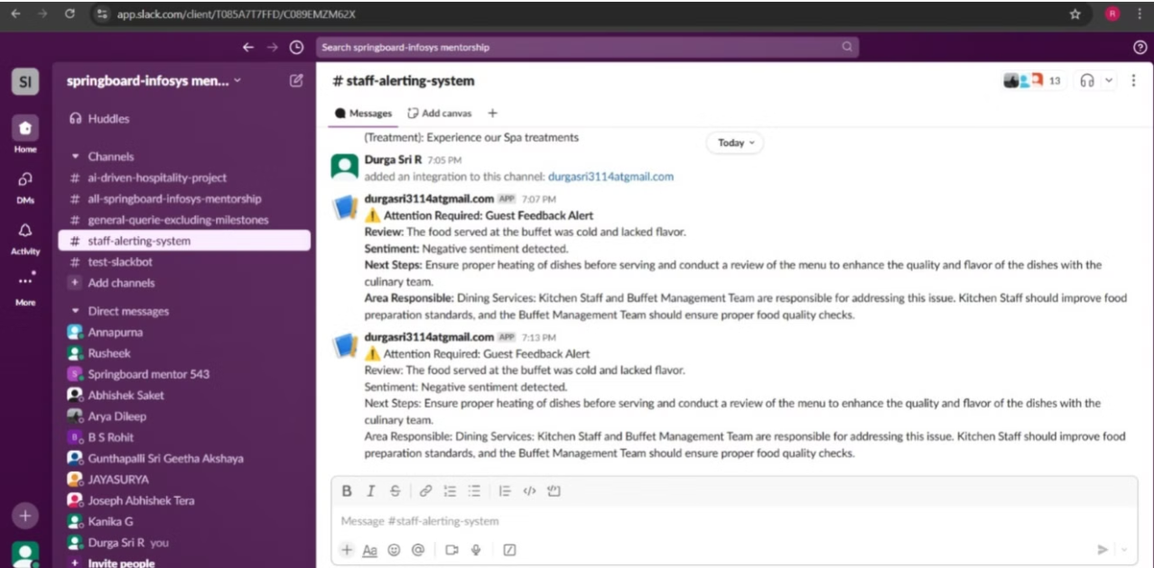
Demo screenshots:
Slack alerts
The system will send a negative feedback alert to the designated Slack channel whenever a guest expresses dissatisfaction. This alert will include details such as the guest's name, their feedback, and the timestamp. Staff can then use this information to address the issue promptly and improve guest satisfaction.

Slide 8
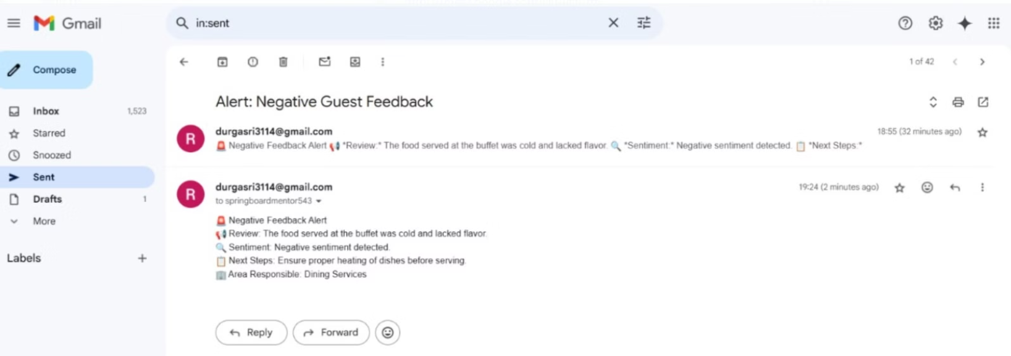
Email alerts
The system sends automated email alerts to guests and staff. Guests receive personalized updates and confirmations, while staff receive notifications about critical issues or urgent requests. This feature enhances communication and responsiveness, improving the overall guest experience and operational efficiency.

Slide 9

Thank You! 😊

